Slide 1

CAPSTONE PROJECT Image Classification of Dog Breeds Using Transfer Learning Techniques
Presented By
Student Name : Vanapalli madhu kishore
College Name : Seshadripuram degree collage
Department : BCA
EmailID : vanapallimadhukishore2@gmail.com
AICTE Student ID : STU67716223e72d21735483939

Slide 2
OUTLINE
Problem Statement (Should not include solution)
Proposed System/Solution
System Development Approach (Technology Used)
Algorithm & Deployment
Result (Output Image)
Conclusion
Future Scope
References

Slide 3
Problem Statement
Identifying dog breeds from images is important for pet adoption, veterinary services, and training programs. However, manually recognizing breeds can be challenging due to the wide variety of dog appearances and similarities between breeds.
The main issues we face are:
Variability in Images: Dogs can look different based on lighting, angles, and image quality, making it hard to identify their breed accurately.
Need for Automation: A system is needed that can automatically classify dog breeds from images, saving time and reducing human error.
Learning from Data: We need a model that can learn from a large dataset of labeled dog images to recognize the unique features of each breed.
Generalization: The model must perform well on new, unseen images to ensure reliable breed identification in real-life situations.

Slide 4
Proposed Solution
Proposed Solution:
To tackle the challenge of identifying dog breeds from images, we propose the following solution:
Data Collection:
Gather a comprehensive dataset of dog images along with their corresponding breed labels. This dataset will serve as the foundation for training our model.
Data Preprocessing:
Clean and prepare the images by resizing them and normalizing pixel values. This ensures consistency and improves model performance.
Data Augmentation:
Apply various image augmentation techniques (like flipping, brightness adjustment, and dropout) to increase the diversity of our training data. This helps the model learn better and become more robust against variations in real-world images.
Model Development:
Utilize a pre-trained deep learning model (InceptionV3) to leverage existing knowledge from image classification tasks. We will customize this model by adding new layers to adapt it specifically for dog breed classification.
Training and Validation:
Train the model using the prepared dataset while validating its performance on a separate validation set. We will monitor metrics like accuracy and AUC to ensure the model is learning effectively.
Deployment:
Once trained, the model will be deployed to classify dog breeds from new images, providing an automated solution for breed identification.

Slide 5
System Approach
To develop the dog breed identification system, we will follow a clear strategy:
Hardware : A computer with a GPU for efficient deep learning.
System Requirements:
Software: Python with essential libraries for data processing and model training.
Required Libraries:
Data Handling:
‘Pandas’ for data manipulation.
‘Numpy’ for numerical operations.
Image Processing:
‘opencv’ for image handling.
‘albumentations’ for data augmentation.

Slide 6
Machine Learning:
‘Tensorflow’ and ‘keras’ for building the model.
Visualization:
‘matplotlib’ and ‘seaborn’ for plotting results.
Development Methodology:
Data Collection: Gather a diverse dataset of dog images and labels.
Preprocessing: Clean and resize images for training.
Model Training: Fine-tune a pre-trained model (InceptionV3) for breed classification.
Evaluation: Monitor performance using validation metrics.

Slide 7
Algorithm & Deployment
Algorithm Selection:
We will use a Convolutional Neural Network (CNN) for dog breed identification. CNNs are well-suited for image classification tasks because they can automatically learn and extract features from images, making them effective for recognizing patterns in visual data. This choice is justified by the need to accurately classify diverse dog breeds based on their unique visual characteristics.
Data Input:
The input features for our model will include:
Images of Dogs: The primary input will be the images of dogs that we want to classify.
Labels: Each image will be associated with a breed label, which the model will learn to predict.
Augmented Data: We will also use augmented versions of the images to enhance the training dataset and improve model robustness.
Training Process:
The CNN will be trained using the labeled dataset of dog images. Key considerations during training include:
Data Augmentation: Applying techniques like rotation, flipping, and brightness adjustments to increase the diversity of the training data.
Cross-Validation: We will use a validation set to monitor the model's performance and prevent overfitting.
Hyperparameter Tuning: Adjusting parameters such as learning rate, batch size, and the number of epochs to optimize model performance.
Prediction Process:
Once trained, the model will predict dog breeds from new images. The prediction process involves:
Image Preprocessing: New images will be resized and normalized to match the training data format.
Real-Time Input: The model will take real-time images as input and output the predicted breed label, allowing for immediate identification.

Slide 8
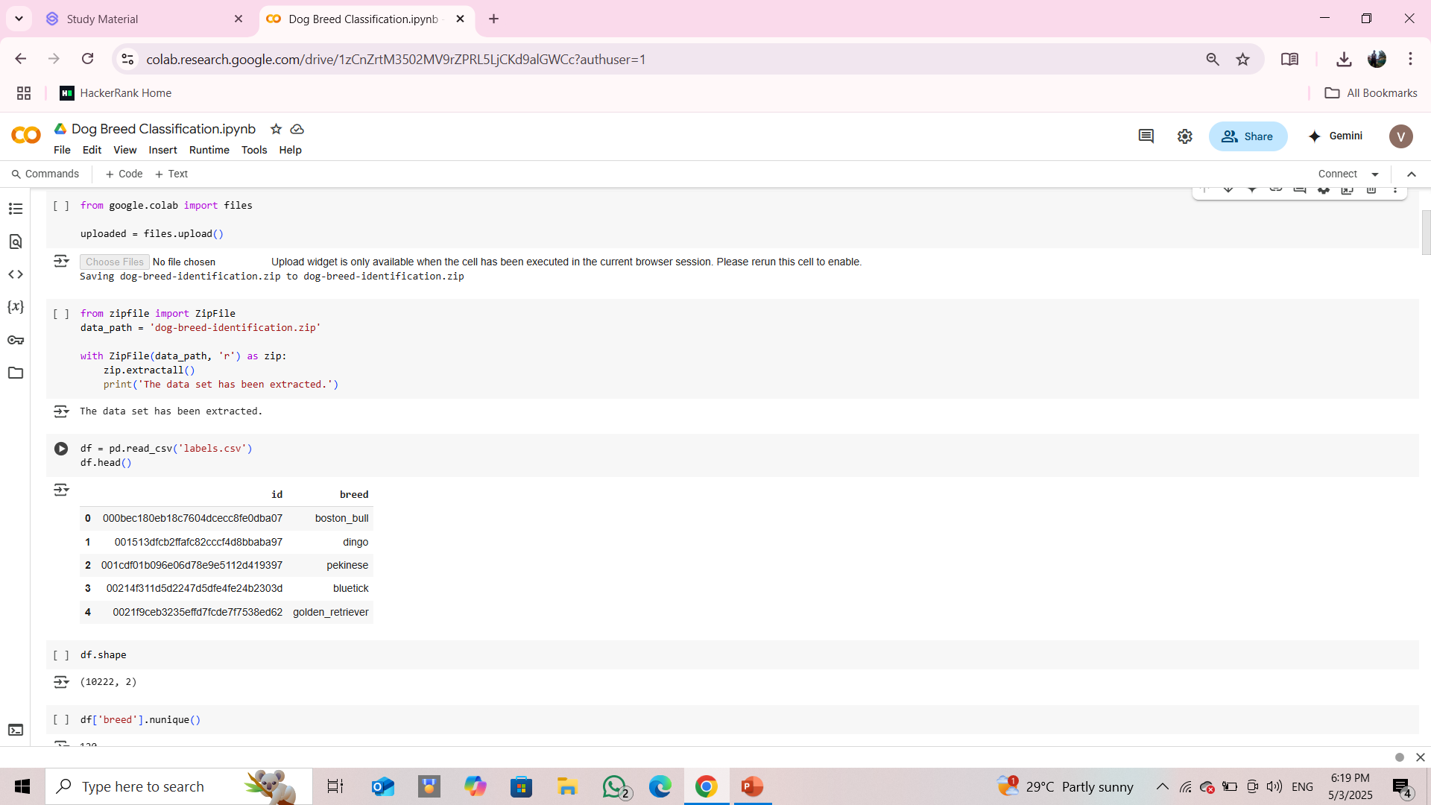
Result:

Slide 9
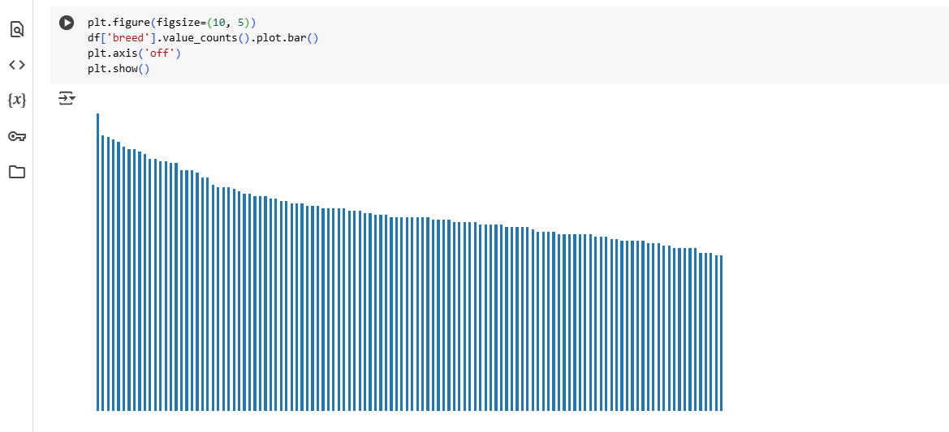
120 unique breed data:

Slide 10
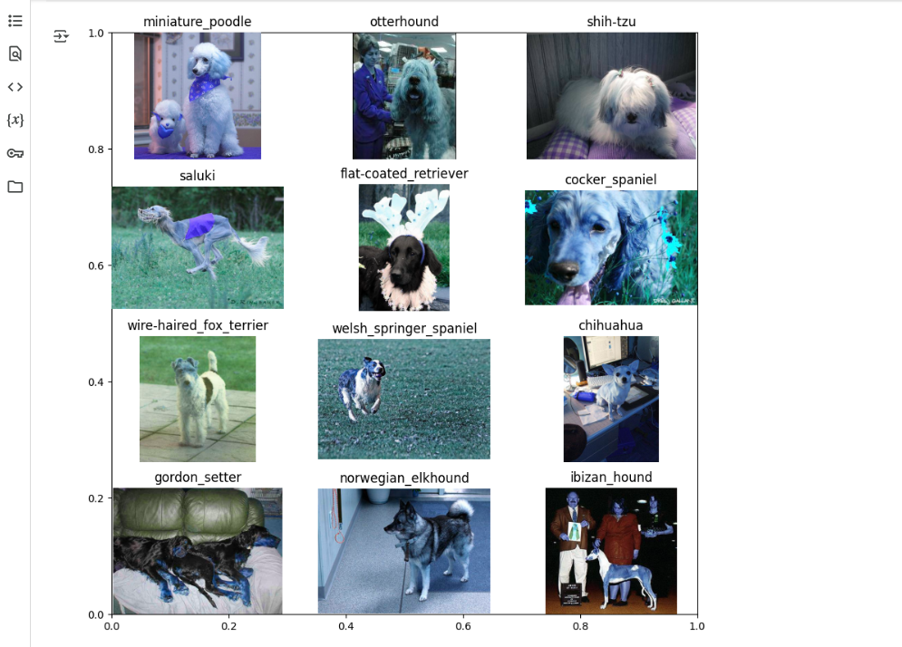
visualizing one image from each class is not feasible but let’s view some of them:

Slide 11
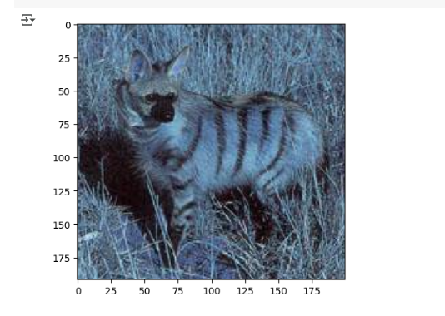
Albumentation by applying it to some sample images:

Slide 12
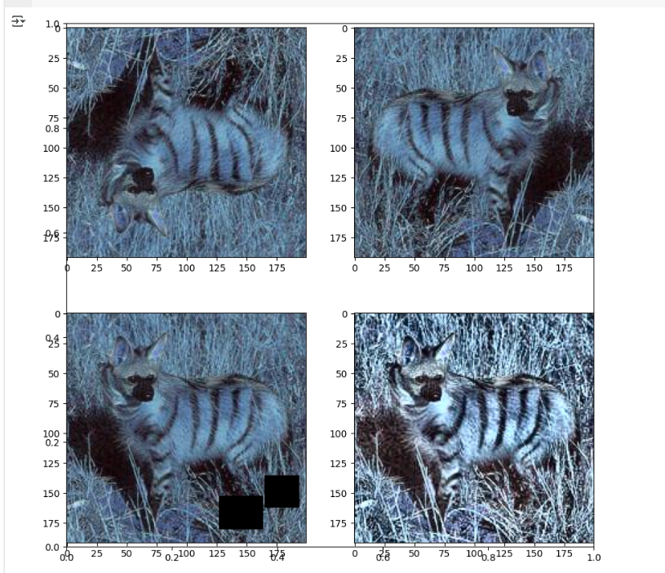
VerticalFlip, HorizontalFlip, CoarseDropout, and CLAHE, and visualize the results:

Slide 13
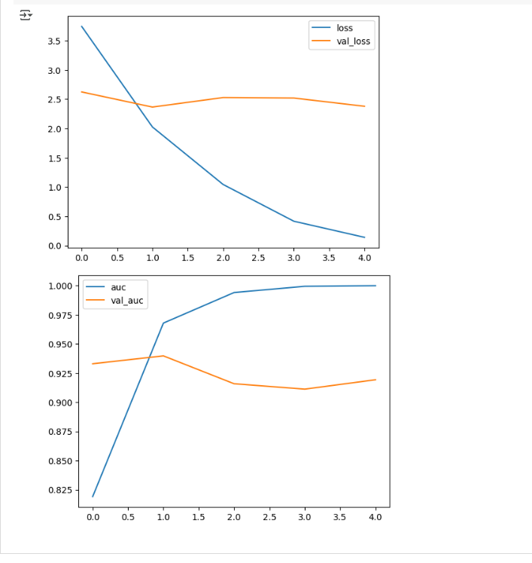
Evaluate the Model:

Slide 14
Conclusion
In this project, we developed a dog breed identification system using a Convolutional Neural Network (CNN) to classify dog breeds from images. Our findings indicate that the proposed solution effectively leverages deep learning techniques to achieve high accuracy in breed classification.
Key Points:
Effectiveness: The CNN model demonstrated strong performance in identifying various dog breeds, showcasing its ability to learn and generalize from the training data.
Challenges: We faced challenges such as ensuring data quality, managing the diversity of dog breeds, and preventing overfitting during training. Data augmentation techniques helped mitigate some of these issues.
Improvements: Future enhancements could include expanding the dataset with more diverse images, experimenting with different architectures, and integrating real-time feedback mechanisms for continuous learning.
Accurate dog breed identification is crucial for various applications, including pet adoption and veterinary care, as it helps ensure that dogs are matched with the right owners and receive appropriate care. This system has the potential to significantly improve the efficiency of breed identification processes in real-world scenarios.

Slide 15
Future scope
The dog breed identification system has significant potential for enhancements and expansions. Here are some key areas for future development:
Additional Data Sources:
Incorporating more diverse datasets, including images from different angles, lighting conditions, and environments, can improve the model's robustness and accuracy.
Integrating metadata such as age, size, and health information of the dogs could provide more context for breed identification.
Algorithm Optimization:
Exploring advanced machine learning techniques, such as transfer learning with more sophisticated models (e.g., EfficientNet or ResNet), could enhance prediction accuracy.
Implementing techniques like ensemble learning could combine multiple models to improve overall performance.
Geographical Expansion:
Expanding the system to cover multiple cities or regions can help in understanding breed popularity and trends in different areas, aiding shelters and adoption services in better matching dogs with potential owners.
Real-Time Applications:
Integrating edge computing can allow the model to run on mobile devices or cameras, enabling real-time breed identification in various settings, such as shelters or veterinary clinics.
User Engagement:
Developing a user-friendly application that allows pet owners to upload images for breed identification and receive information about care and training specific to their dog’s breed.

Slide 16
References
Other References links:
https://www.geeksforgeeks.org/
GitHub Link: https://github.com/madhukishore2005/-Image-Classification-of-Dog-Breeds-Using-Transfer-Learning-Techniques.git

Slide 17
Thank you

